Slide 1
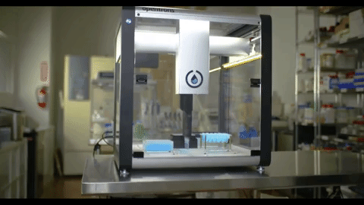
Using agents for autonomous labs
erhtjhtyhy
Brian Hsu
Priyanka Setty
Notes:
Today, we'll embark on a journey through the cutting-edge realm of Multi-Agent Systems (MAS) and their transformative impact on software development. Our focus will be on understanding the core principles of MAS and showcasing a demonstration of MAS-driven code generation.

Slide 2
Challenges in traditional Laboratory
Challenge: Traditional experimentation processes can be slow due to manual task execution, limiting the speed of discovery.
Solution: By automating tasks, autonomous labs streamline workflows and accelerate the experimentation process, enabling faster discovery and innovation.
Challenge: Human labor is limited by the need for rest and breaks, reducing lab operational hours.
Solution: Robots and automated systems can operate continuously, 24/7, significantly increasing lab productivity by eliminating downtime
Challenge: Manual experiments are prone to human error, leading to inconsistencies in data and a lack of reproducibility.
Solution: Automation ensures precise and consistent execution of experiments, minimizing human error and enhancing the reliability and reproducibility of data.

Slide 3
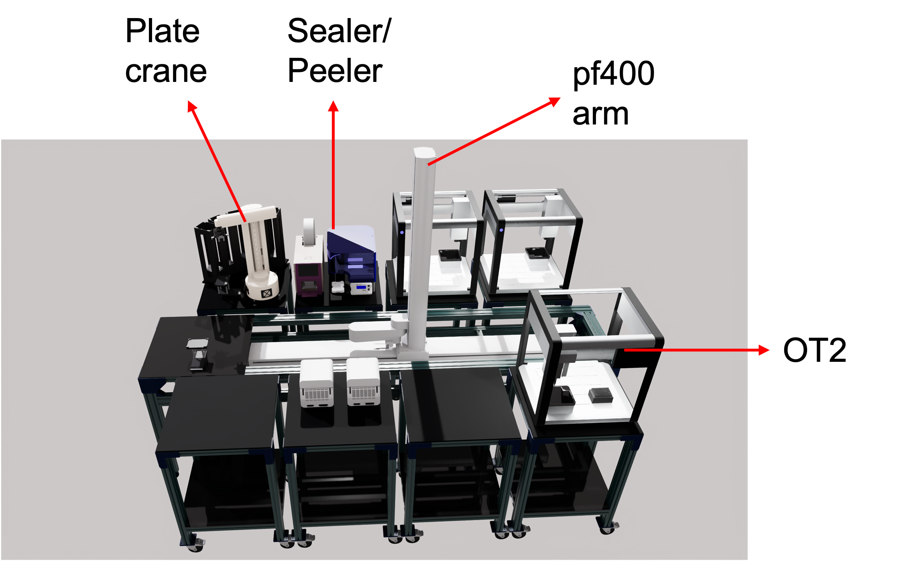
What is autonomous laboratory?
A system that can perform scientific experiments and research with minimal human intervention
What are the key components of SDL?
Robotic automation
AI-powered design
Closed-loop systems
Rapid prototyping laboratory Setup at Argonne National Laboratory

Slide 4
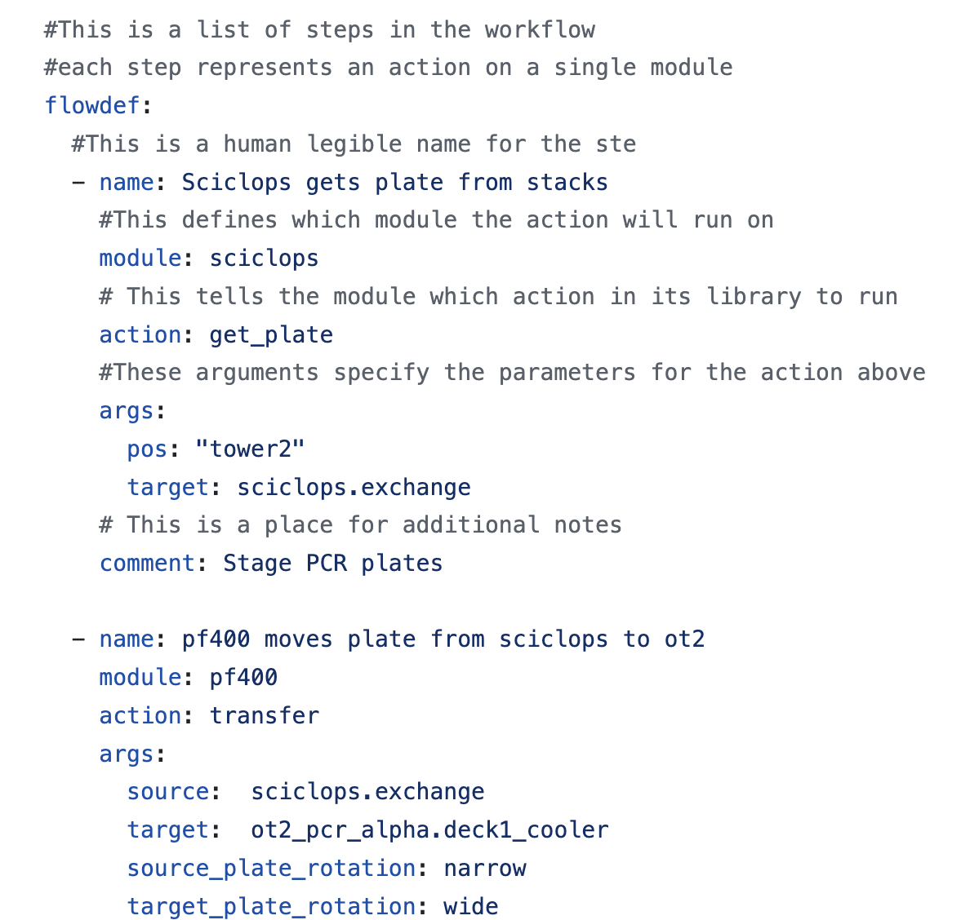
Agent-Based Code Generation
Unlike static manual scripts, agent based models can dynamically generate and adjust experimental protocols in real-time, responding to new data, experimental outcomes, or changing conditions.
Can handle complex, multi-faceted problems by breaking them down into smaller tasks managed by individual agents, facilitating more efficient problem-solving and decision-making processes.
Are inherently scalable, capable of managing tasks ranging from simple to highly complex experimental designs, making them ideal for labs of any size and capability.

Slide 5
What is AN AI AGENT?
An AI agent is a software program designed to autonomously perform tasks or make decisions to achieve specific goals.
AI agents improve over time through data analysis and feedback, enhancing their decision-making and performance
AI agents operate without the need for constant human guidance
They can adjust their actions and strategies in response to changing environments or objectives
AI agents can work together with other agents, sharing knowledge and tasks to achieve complex goals
Notes:
An AI agent is a software program designed to autonomously perform tasks or make decisions to achieve specific goals
It learns from data, adapts to new scenarios, and operates independently
Characteristics of AI Agents
Learning: "AI agents improve over time through data analysis and feedback, enhancing their decision-making and performance."
Autonomy: "Equipped with the ability to make independent decisions, AI agents operate without the need for constant human guidance."
Adaptability: "They can adjust their actions and strategies in response to changing environments or objectives."
Collaborative Intelligence: "AI agents can work together with other agents, sharing knowledge and tasks to achieve complex goals."
Types of AI Agents
Reactive Agents: Operate based on current perceptions without considering the past or future implications.
Deliberative/Goal-Based Agents: Plan and make decisions based on desired outcomes, often employing complex algorithms to forecast future states.
Utility-Based Agents: Make decisions to maximize a certain utility function, which evaluates the success of an outcome.
Learning Agents: Continuously improve their performance by learning from their environment and past actions, often through techniques like machine learning and deep learning.

Slide 6
Multi-Agent systems (MAS)
Multiple AI agents can collaborate, enhancing problem-solving and efficiency beyond what single agents can achieve
Advantages
Complex Problem Solving
Increased Efficiency
Robust System
MAS can expand more easily to accommodate larger or more complex tasks, adapting to the demand seamlessly
Agents with different specialties can address varied aspects of a problem, leading to well-rounded and thorough solutions
Agents in a MAS can learn from one another’s experiences, constantly evolving and optimizing collective strategies
Notes:
The Strength
Complex Problem Solving: "Together, multiple AI agents can tackle intricate problems more efficiently by dividing and conquering."
Increased Efficiency: "Collaborative efforts lead to faster solutions and innovations, as agents share workloads and insights."
Resilience in Numbers: "A collective of AI agents brings robustness to systems, ensuring stability even if individual agents face errors or disruptions."
Advantages Over Single Agent Systems
Scalability: "MAS can expand more easily to accommodate larger or more complex tasks, adapting to the demand seamlessly."
Diverse Skillsets: "Agents with different specialties can address varied aspects of a problem, leading to well-rounded and thorough solutions."
Enhanced Learning: "Agents in a MAS can learn from one another’s experiences, constantly evolving and optimizing collective strategies."

Slide 7
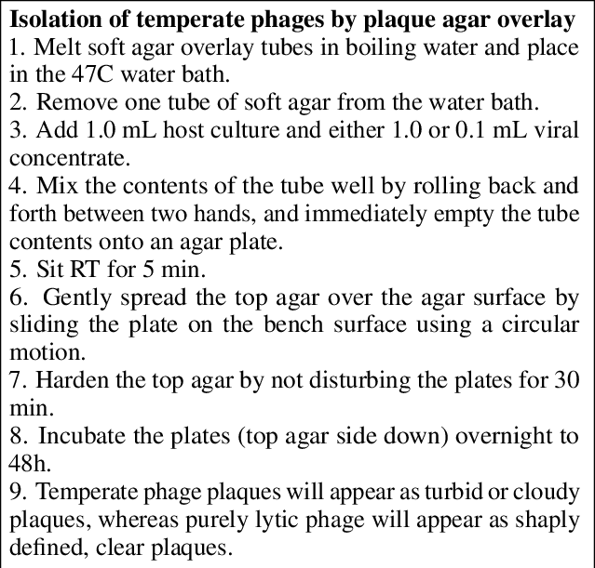

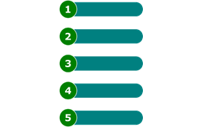
Automating Labs with code Agents
Issue: Some lab protocols in biology are tedious (ex. liquid handling tasks such as serial dilution)
Potential Solution: We can use LLM-driven “agents” aka language models to generate/evaluate code → used to operate robots to carry out lab tasks
Input = lab experiment/information as a prompt → GPT Agent → code to control robot → executed protocol
GPT
List of Tasks
Code

Slide 8
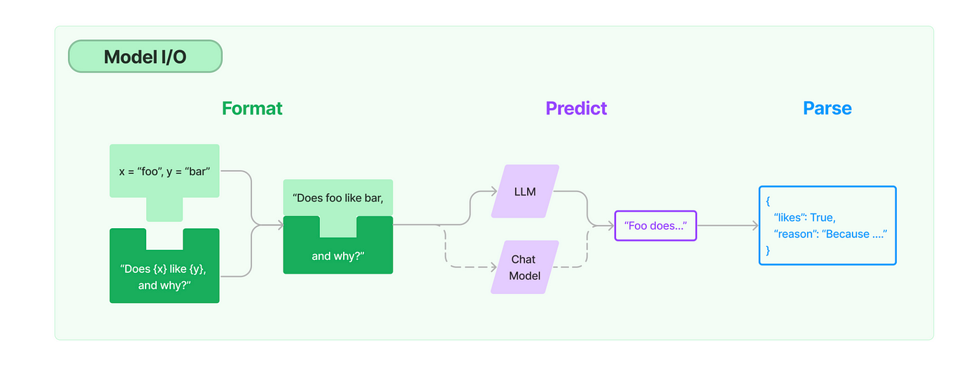
Langchain – Easy to use for LLMs
LangChain is a Python API that helps you compose prompts and send them into an LLM model (‘chain’) to generate responses, embeddings, etc.
We can “chain” LLM models together to create an ecosystem of language models for planning, code generation to execute a biology experiment

Slide 9
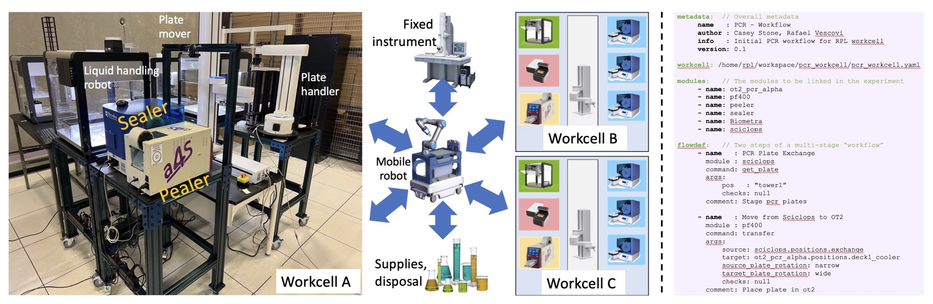
Scaling toward PCR
Issue: We have a complex experiment that includes multiple preparation steps
Ex. Master mix preparation, thermocycling, all in one plate???

Slide 10
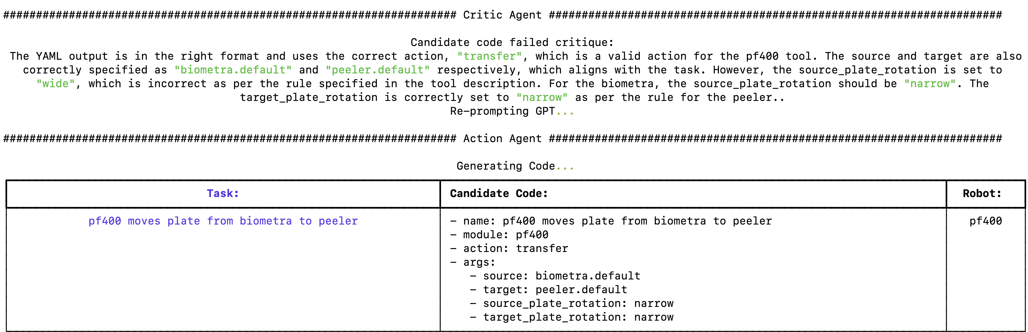
Example of what we do…
We use Langchain agents to generate/evaluate code (yaml/json format)
Communicates with different robots via code payload
https://drive.google.com/file/d/19wg8W4lifPk1Ie827rXxSWY9wohNrfsD/view?usp=drive_link

Slide 11
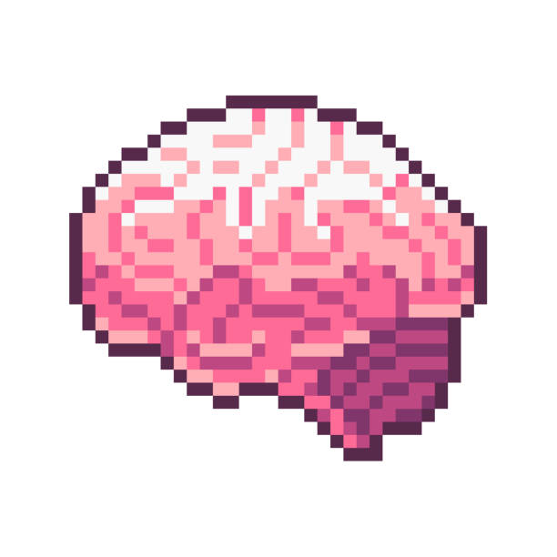
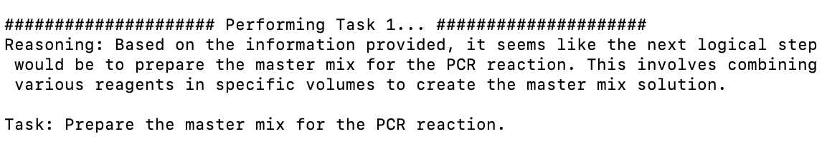
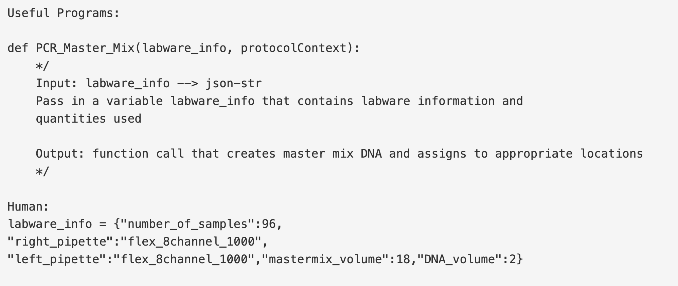
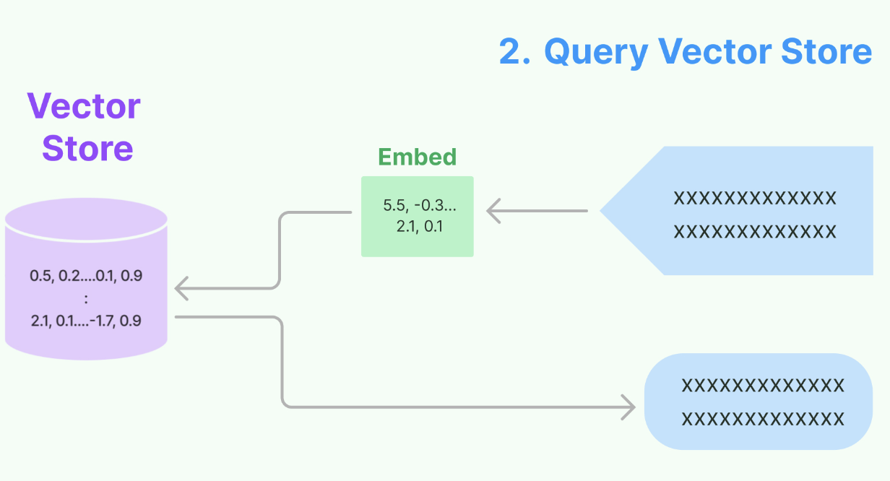

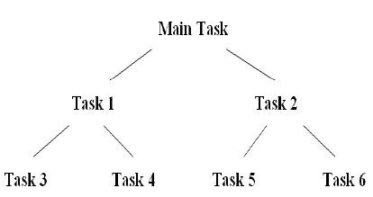

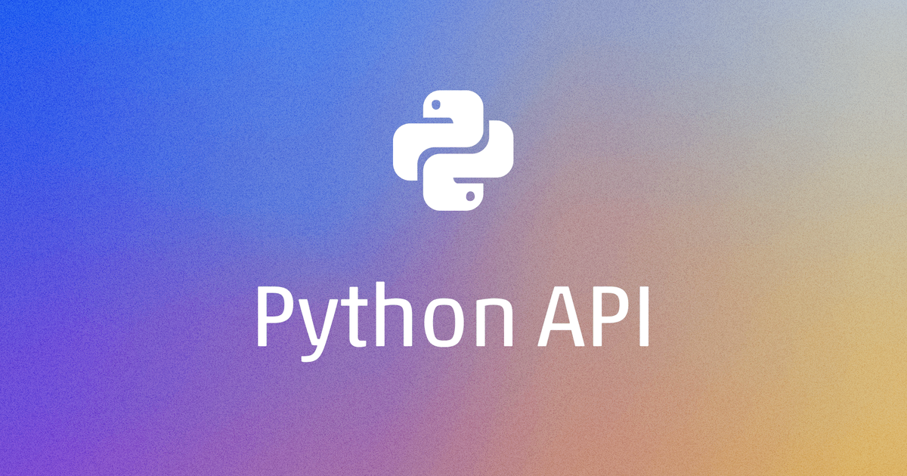

System of Agents
Candidate Code
Agent
Memory of Tasks
Memory
Task Prompt
Retrieve
Skills
Task Decomp.
Goal Tracking
Code Action
Execution Error
Add Code Skill
Refine Code
Verify Code

Slide 12
GOOGLE colab example
We can use LangChain API to generate Opentrons python code
Opentrons is a python api that is used to control liquid handling robots + thermocyclers → let’s generate some sample code
https://colab.research.google.com/drive/1MLKC9usK-rVZv42exuPgRV398hIHAfcZ?usp=sharing

